Slide 1
Topic Modeling
Peitian Zhang
Renmin University of China
Currently @ MSRA Social Computing

Slide 2
Outline
Overview
Math Fundations
Datasets
Metrics
Traditional Methods
Neural Methods
Bert-based Methods

Slide 3
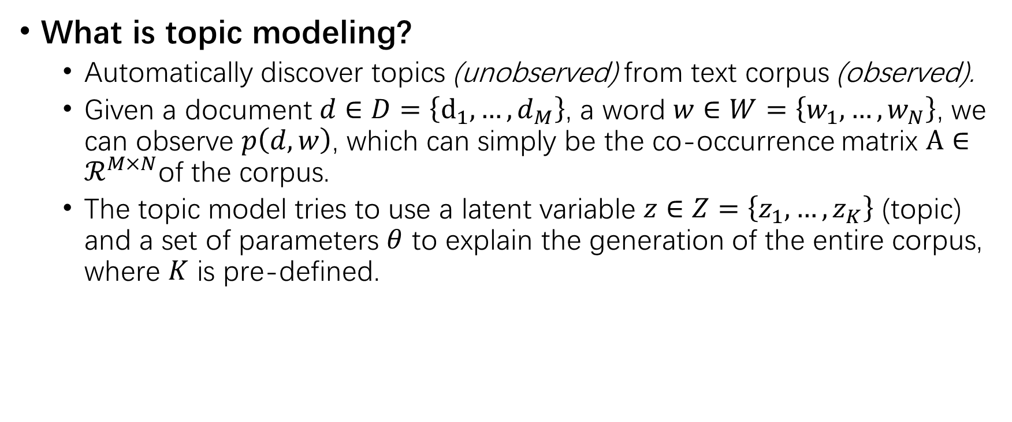
Overview
What is topic modeling?
Automatically discover topics (unobserved) from text corpus (observed).
Given a document $d∈D=\left\{d_{1},…, d_{M}\right\}$, a word $w∈W=\left\{w_{1},…,w_{N}\right\}$, we can observe $p\left(d,w\right)$, which can simply be the co-occurrence matrix $A∈ℛ^{M×N}$of the corpus.
The topic model tries to use a latent variable $z∈Z=\left\{z_{1},…,z_{K}\right\}$ (topic) and a set of parameters $θ$ to explain the generation of the entire corpus, where $K$ is pre-defined.

Slide 4
Overview
Why do we need topic modeling?
It facilitates many web applications including document analysis, text summarization and ad-hoc information retrieval.

Slide 5
Math

Slide 6


Datasets
20Newsgroups
A collection of approximately 20,000 newsgroup articles, partitioned evenly across 20 different newsgroups.
NYTimes
A collection of news articles published between 1987 and 2007, and contains a wide range of topics, such as sports, politics, education, etc.
Yelp
The Yelp Review Challenge dataset.

Slide 7
Traditional Methods
Resort to analytic solutions
Difficult math

Slide 8
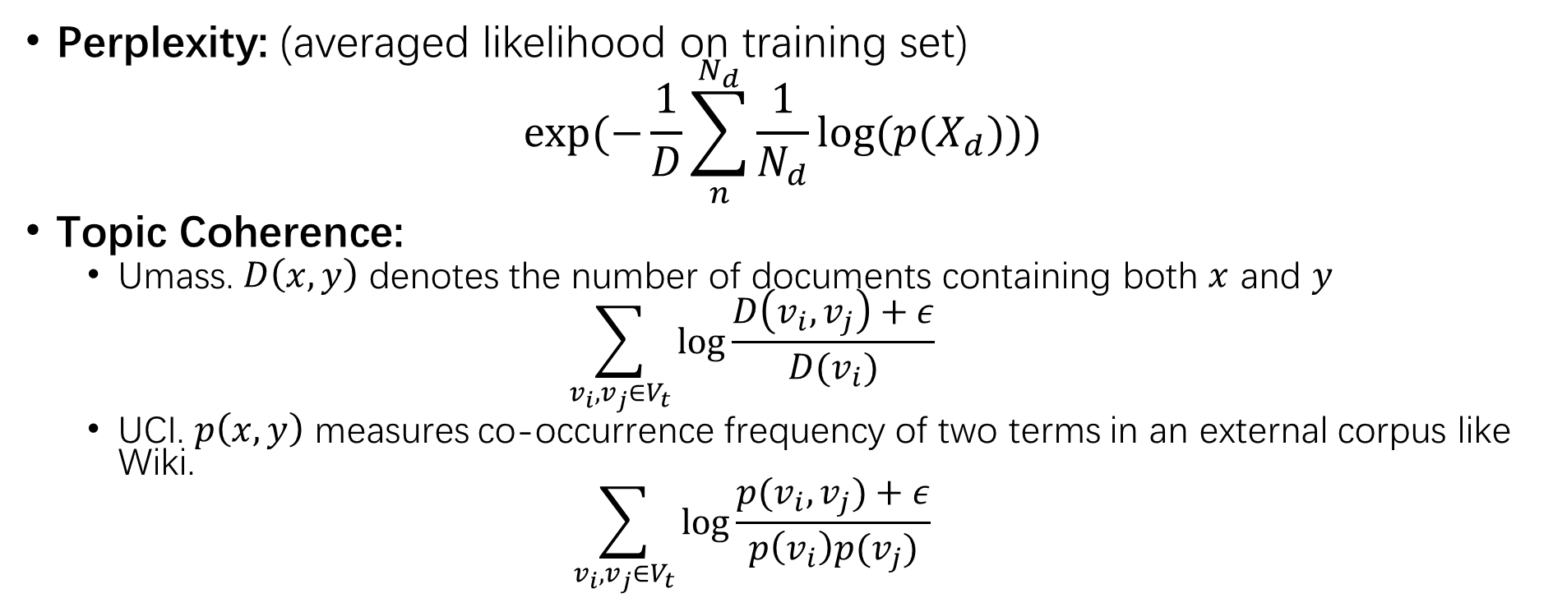
Metrics
Perplexity: (averaged likelihood on training set)
$$exp⁡(−\frac{1}{D}\sum_{n}^{N_{d}}{\frac{1}{N_{d}}log⁡(p(X_{d}))})$$
Topic Coherence:
Umass. $D\left(x,y\right)$ denotes the number of documents containing both $x$ and $y$
$$\sum_{v_{i},v_{j}∈V_{t}}{\log{\frac{D\left(v_{i},v_{j}\right)+ε}{D(v_{i})}}}$$
UCI. $p\left(x,y\right)$ measures co-occurrence frequency of two terms in an external corpus like Wiki.
$$\sum_{v_{i},v_{j}∈V_{t}}{\log{\frac{p(v_{i},v_{j})+ε}{p\left(v_{i}\right)p(v_{j})}}}$$

Slide 9
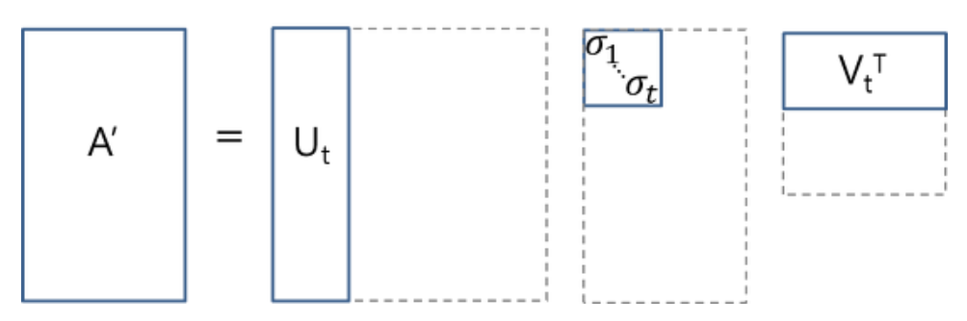
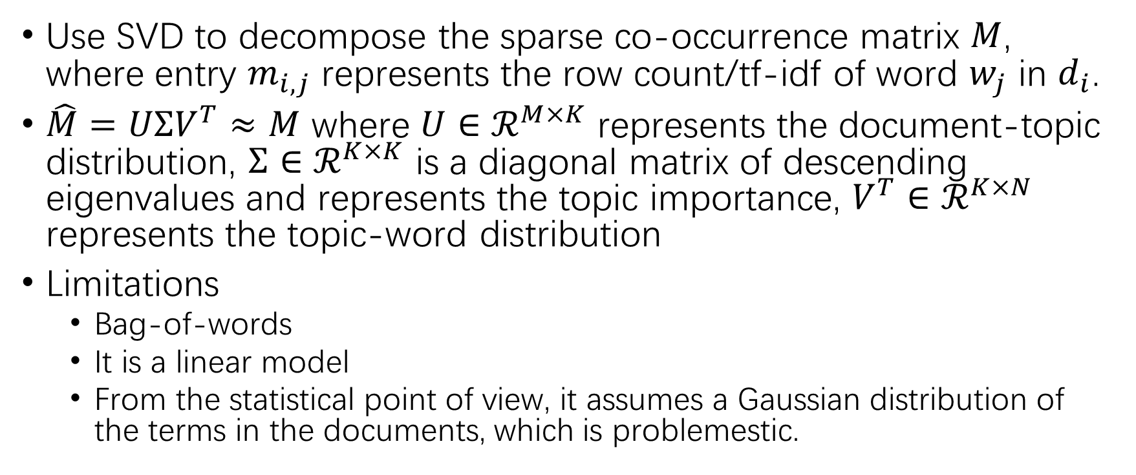
LSA
Use SVD to decompose the sparse co-occurrence matrix $M$, where entry $m_{i,j}$ represents the row count/tf-idf of word $w_{j}$ in $d_{i}$.
$\hat{M}=UΣV^{T}≈M$ where $U∈ℛ^{M×K}$ represents the document-topic distribution, $Σ∈ℛ^{K×K}$ is a diagonal matrix of descending eigenvalues and represents the topic importance, $V^{T}∈ℛ^{K×N}$ represents the topic-word distribution
Limitations
Bag-of-words
It is a linear model
From the statistical point of view, it assumes a Gaussian distribution of the terms in the documents, which is problemestic.

Slide 10
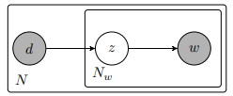
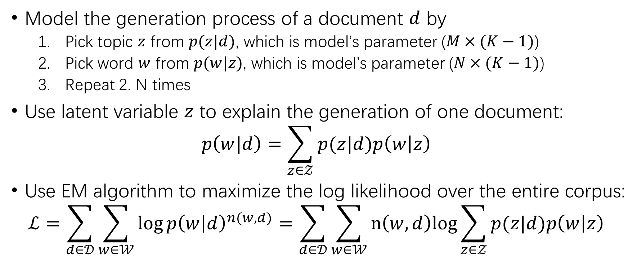
PLSA
Model the generation process of a document $d$ by
Pick topic $z$ from $p(z|d)$, which is model’s parameter ($M×(K−1)$)
Pick word $w$ from $p(w|z)$, which is model’s parameter ($N×(K−1)$)
Repeat 2. N times
Use latent variable $z$ to explain the generation of one document:
$$p\left(w|d\right)=\sum_{z∈𝒵}{p(z|d)p\left(w | z\right)}$$
Use EM algorithm to maximize the log likelihood over the entire corpus:
$$ℒ=\sum_{d∈𝒟}{\sum_{w∈𝒲}{\log{p{\left(w | d\right)}^{n(w,d)}}=\sum_{d∈𝒟}{\sum_{w∈𝒲}{n\left(w,d\right)log{\sum_{z∈𝒵}{p(z|d)p\left(w | z\right)}}}}}}$$

Slide 11
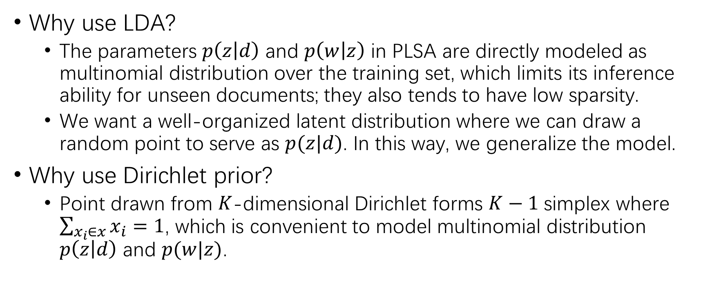
LDA
Why use LDA?
The parameters $p\left(z | d\right)$ and $p\left(w | z\right)$ in PLSA are directly modeled as multinomial distribution over the training set, which limits its inference ability for unseen documents; they also tends to have low sparsity.
We want a well-organized latent distribution where we can draw a random point to serve as $p(z|d)$. In this way, we generalize the model.
Why use Dirichlet prior?
Point drawn from $K$-dimensional Dirichlet forms $K−1$ simplex where $\sum_{x_{i}∈x}{x_{i}}=1$, which is convenient to model multinomial distribution $p\left(z | d\right)$ and $p(w|z)$.

Slide 12
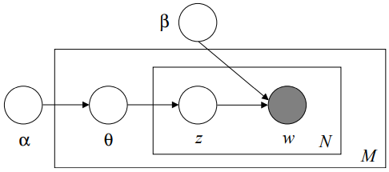
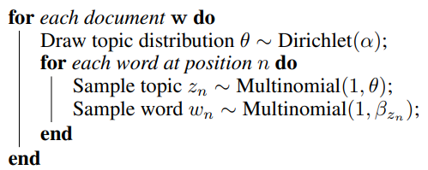
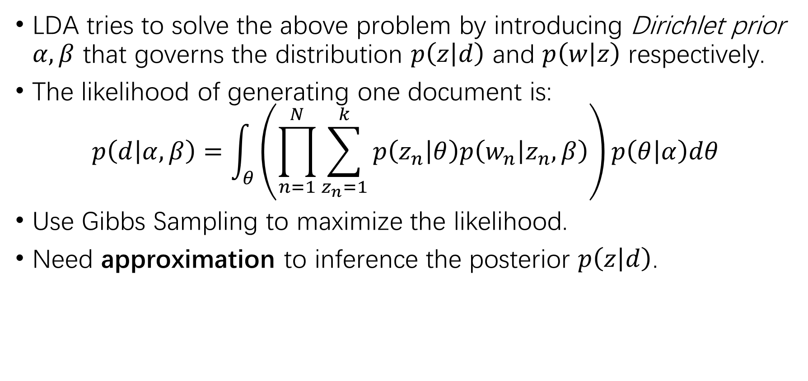
LDA
LDA tries to solve the above problem by introducing Dirichlet prior $α,β$ that governs the distribution $p\left(z | d\right)$ and $p\left(w | z\right)$ respectively.
The likelihood of generating one document is:
$$p\left(d | α, β\right)=\int_{θ}{\left(\prod_{n=1}^{N}{\sum_{z_{n}=1}^{k}{p\left(z_{n} | θ\right)p\left(w_{n} | z_{n},β\right)}}\right)p\left(θ | α\right)dθ}$$
Use Gibbs Sampling to maximize the likelihood.
Need approximation to inference the posterior $p\left(z | d\right)$.

Slide 13
Neural Methods
Aims:
Solve the intractable posterior of LDA
Combine word relatedness(embedding) to Topic Modeling
Methods
Use Variational AutoEncoder as black box to inference
Use Encoder in Adversarial Training as black box to inference
Involve word embedding in forming the latent topic distribution

Slide 14
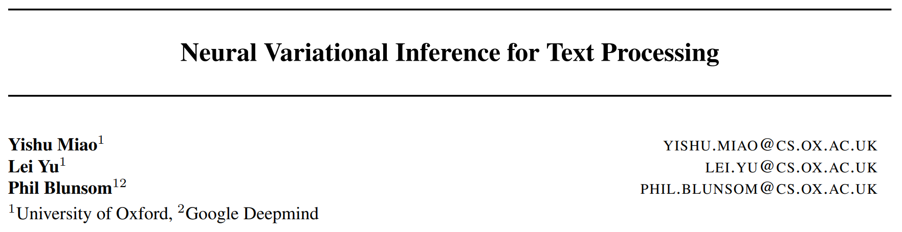
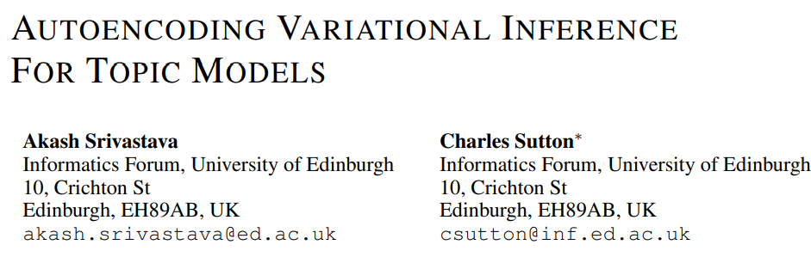
VAE methods
ICML 2016
ICLR 2017

Slide 15
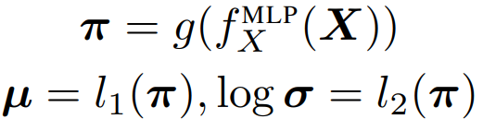

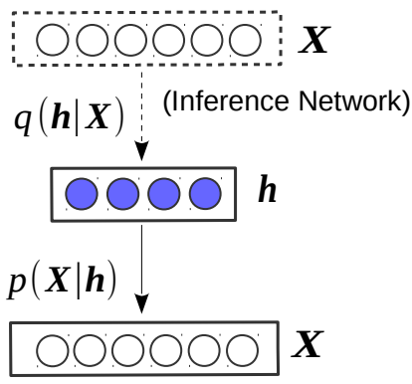
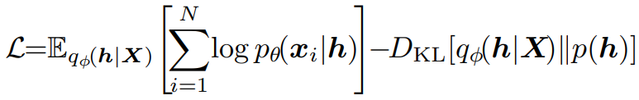
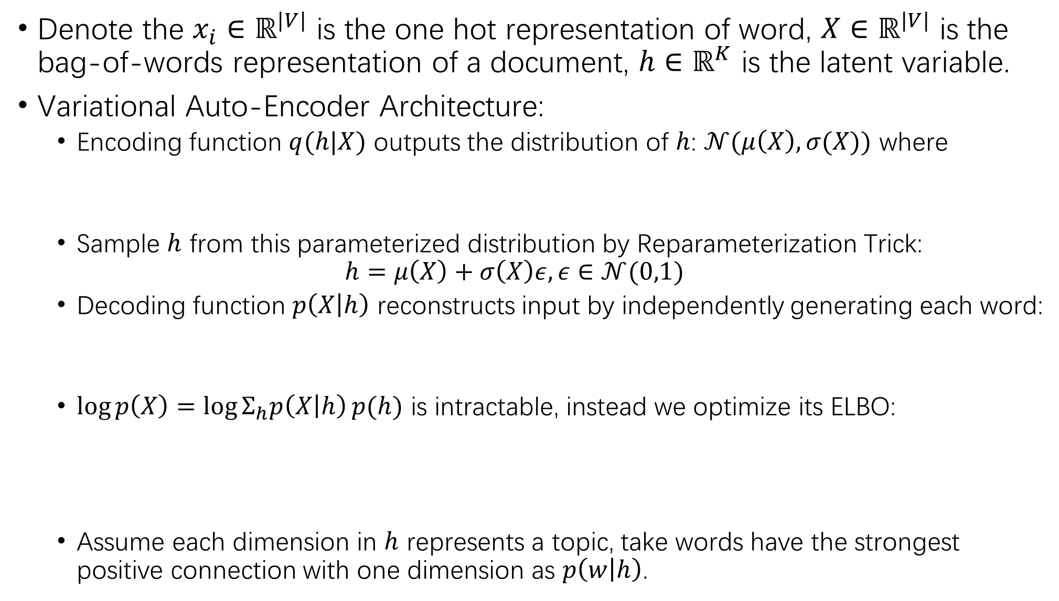
Denote the $x_{i}∈ℝ^{|V|}$ is the one hot representation of word, $X∈ℝ^{|V|}$ is the bag-of-words representation of a document, $h∈ℝ^{K}$ is the latent variable.
Variational Auto-Encoder Architecture:
Encoding function $q(h|X)$ outputs the distribution of $h$: $𝒩(μ\left(X\right),σ(X))$ where
Sample $h$ from this parameterized distribution by Reparameterization Trick:
$$h=μ\left(X\right)+σ\left(X\right)ε, ε∈𝒩(0,1)$$
Decoding function $p\left(X | h\right)$ reconstructs input by independently generating each word:
$\log{p\left(X\right)=\log{Σ_{h}p\left(X | h\right)}p(h)}$ is intractable, instead we optimize its ELBO:
Assume each dimension in $h$ represents a topic, take words have the strongest positive connection with one dimension as $p\left(w | h\right)$.

Slide 16
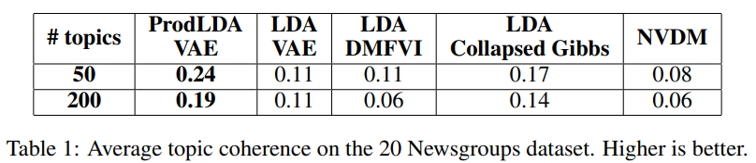
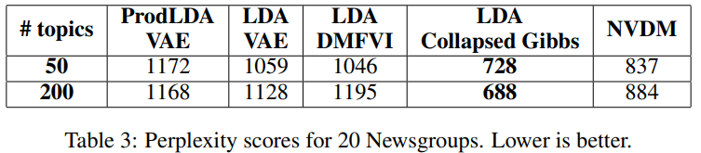
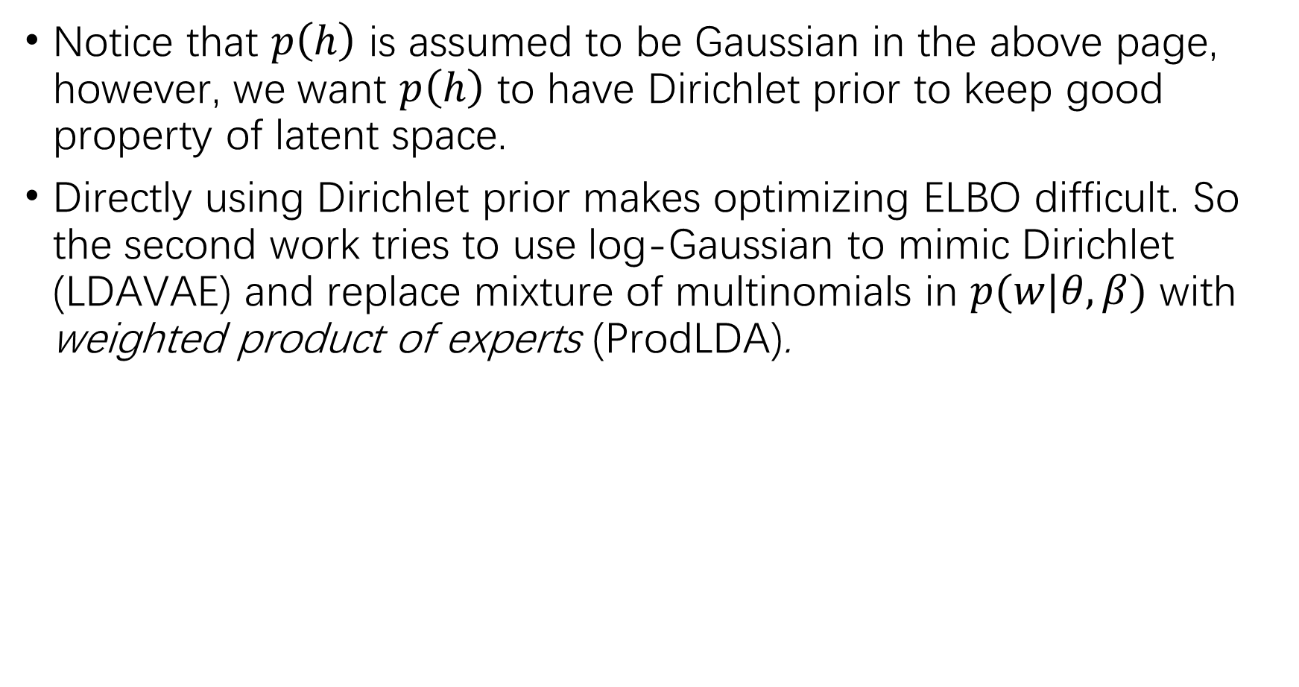
Notice that $p\left(h\right)$ is assumed to be Gaussian in the above page, however, we want $p\left(h\right)$ to have Dirichlet prior to keep good property of latent space.
Directly using Dirichlet prior makes optimizing ELBO difficult. So the second work tries to use log-Gaussian to mimic Dirichlet (LDAVAE) and replace mixture of multinomials in $p(w|θ,β)$ with weighted product of experts (ProdLDA).

Slide 17
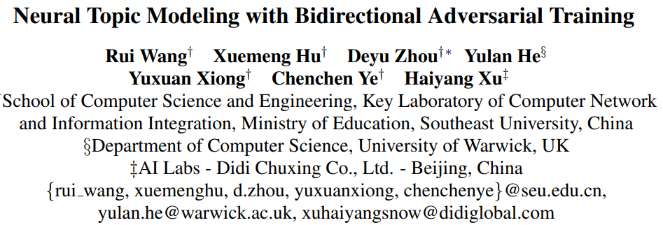
GAN method
ACL 2020

Slide 18
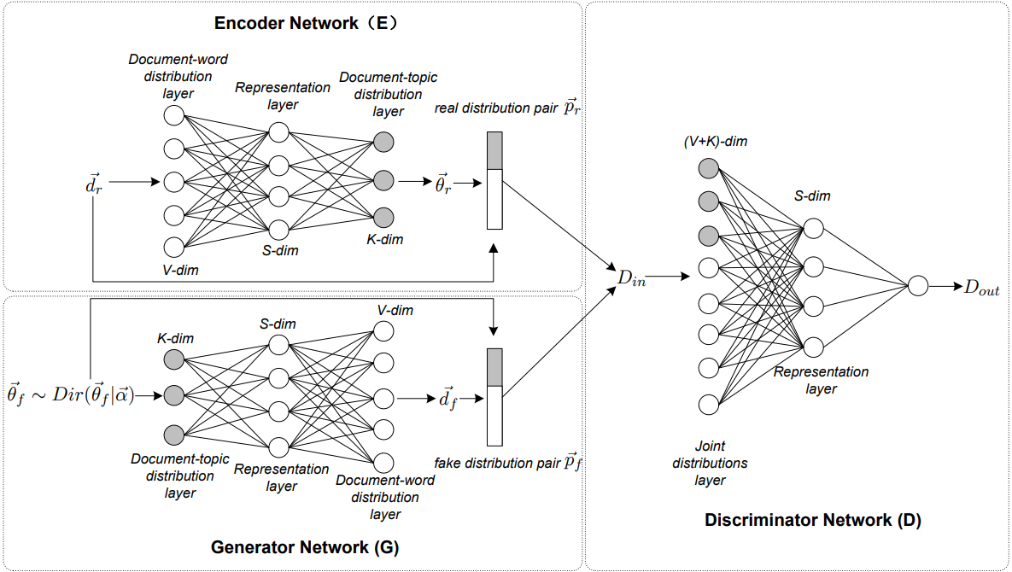
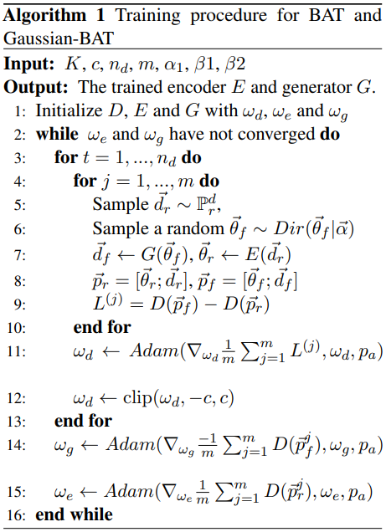
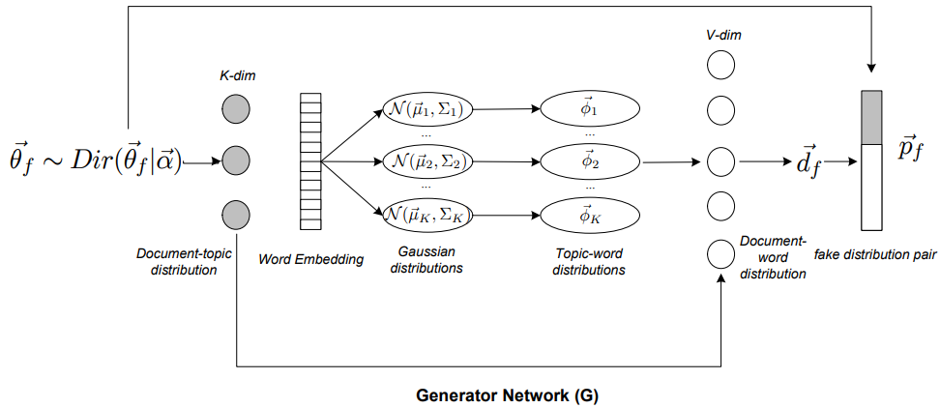

Slide 19
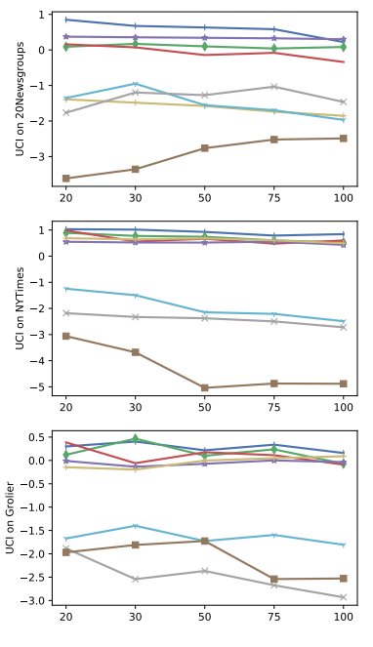
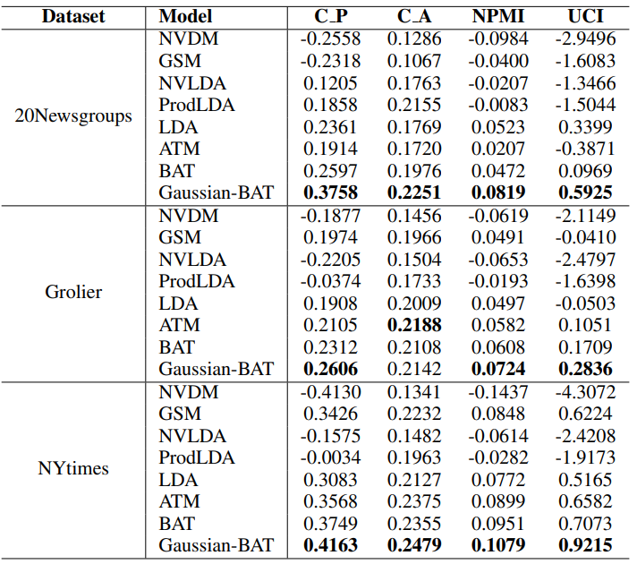

Slide 20
Combine word embedding

